Slide 1
Processing of medical image data by computer vision methods and deep neural networks
By: Ahmed Lotfi Alqnatri
Supervisor: doc. Ing. Vanda Benešová PhD

Slide 2
Goal
Classification of Intracranial hemorrhage and its subtypes
Implement the solution using deep neural networks and frameworks suitable for medical data processing.
Verify the solution by experimenting with real data from medical modalities.
Evaluate the accuracy and results

Slide 3
Motivation
Intracranial hemorrhage (ICH) corresponds to bleeding inside the skull caused by a vascular rupture.
Speed of diagnosis is crucial because approximately half of these deaths occur within the first 24 hours [1].
Must diagnose it properly and quickly.
Up to 20% of patients with suspected ICH may be misdiagnosed.
[1]. CACERES, J. ALFREDO and GOLDSTEIN, JOSHUA N., 2012, Intracranial Hemorrhage. Emergency Medicine Clinics of North America. 2012. Vol. 30, no. 3, p. 771-794. DOI 10.1016/j.emc.2012.06.003. Elsevier BV

Slide 4
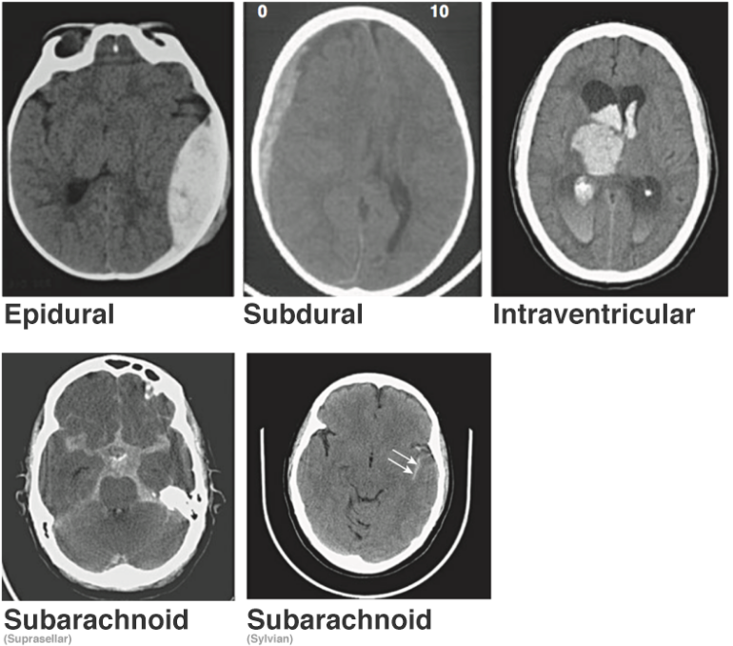
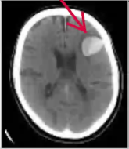
Intracranial
Hemorrhage
ICH
There are 5 types of ICH:
Epidural
Subdural
Intraventricular
Intraparenchymal
Subarachnoid
Figure 1. Intracranial hemorrhage subtypes [1]
[1]. SAGE, AGATA and BADURA, PAWEL, 2020, Intracranial Hemorrhage Detection in Head CT Using Double-Branch Convolutional Neural Network, Support Vector Machine, and Random Forest. Applied Sciences. 2020. Vol. 10, no. 21, p. 7577. DOI 10.3390/app10217577. MDPI AG

Slide 5
State of the art similar work study
Convolutional neural networks for detection intracranial hemorrhage in CT images [1]
Dataset
The chosen Dataset is known as CQ500 Dataset
491 samples
Models
CNN Model
Modified VGG 16
[1]. CASTRO, JUAN SEBASTIAN and CHABERT, STEREN, 2021, Convolutional neural networks for detection intracranial hemorrhage in CT images. Ceur-ws.org [online]. 2021. [Accessed 7 May 2021]. Available from: http://ceur-ws.org/Vol-2564/shortarticle_5-CRoNe2019.pdf

Slide 6
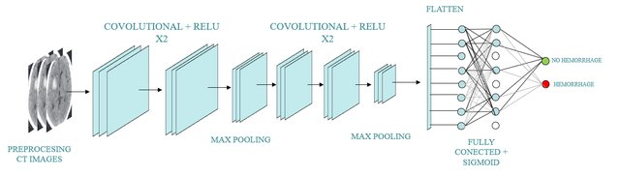
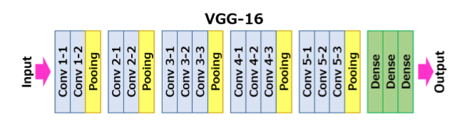
State of the art similar work study
Convolutional neural networks for detection intracranial hemorrhage in CT images [4]
Figure 2. Illustration of the custom CNN model[1]
Figure 3. Illustration of the modified VGG-16 model[1]
[1]. CASTRO, JUAN SEBASTIAN and CHABERT, STEREN, 2021, Convolutional neural networks for detection intracranial hemorrhage in CT images. Ceur-ws.org [online]. 2021. [Accessed 7 May 2021]. Available from: http://ceur-ws.org/Vol-2564/shortarticle_5-CRoNe2019.pdf

Slide 7
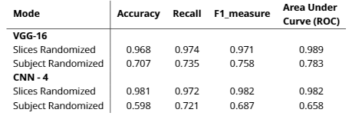
State of the art similar work study
Results
Accuracy of 96.8% for the VGG16 and 98.1% for CNN4
Very similar to the performance.
Convolutional neural networks for detection intracranial hemorrhage in CT images [4]

Slide 8
Our Solution

Slide 9
Dataset
The used Dataset is from “RSNA Intracranial Hemorrhage Detection, Identify acute intracranial hemorrhage and its subtypes” challenge on Kaggle[1]
It contains 752 803 DICOM files
Each file is representing a slice
The files has diameters (512,512)
For the data there is CSV file contains annotations for the corresponding DICOM files

Slide 10
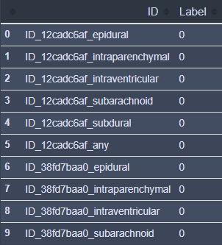
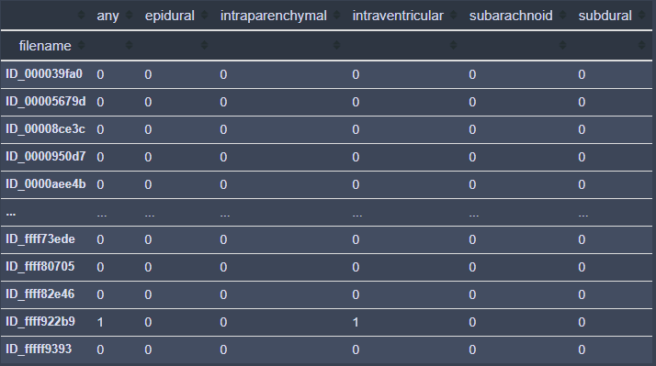
Analyzing Dataset 1. CSV Annotations
It had shape of (4516842, 2)
After modification It has shape of (674257,6)
Table 2. Original table Table 3. Modified table

Slide 11
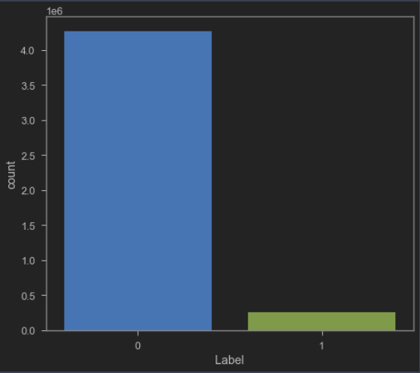
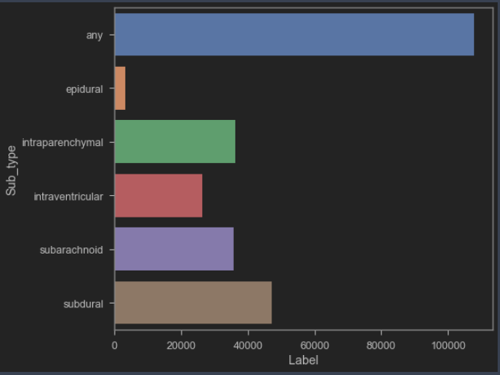
Analyzing Dataset 1. CSV Annotations
After applying EDA on the Dataset “Figure 4”, we noticed that there are a lot more slices of ICH negative than ICH positive
In Figure 5. we can see the ratio difference between each ICH subtype
Figure 4. Graph of ICH positive and negative cases
Figure 5. Graph of ICH subtypes

Slide 12
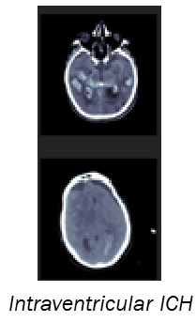
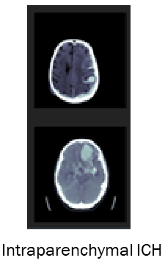
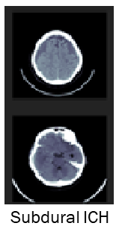
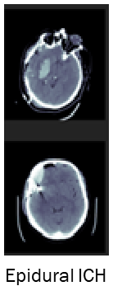
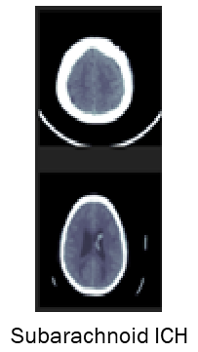
Analyzing Dataset 2. DICOm Files
One pixel array of a file is corrupted “ID_6431af929.dcm”.
78 546 out of 752 803 DICOM file without annotation “Out of use”.
Figure 7. Some examples of ICH cases in our Dataset

Slide 13
Experiment No.1 Binary classification
Image Preprocessing
Remove the background image of all slices
The pixel values of each slice in the dataset were normalized between 0 and 1
Pixel Standardization to scale pixel values to have a zero mean and unit variance.
All preprocessing were done before being passed to the deep learning models
Training and Validating
Choosing randomly 10 000 slices
split the dataset randomly 80% for training and 20% Validating
50 epochs, batch size of 32 and learning rate of 1e-3

Slide 14
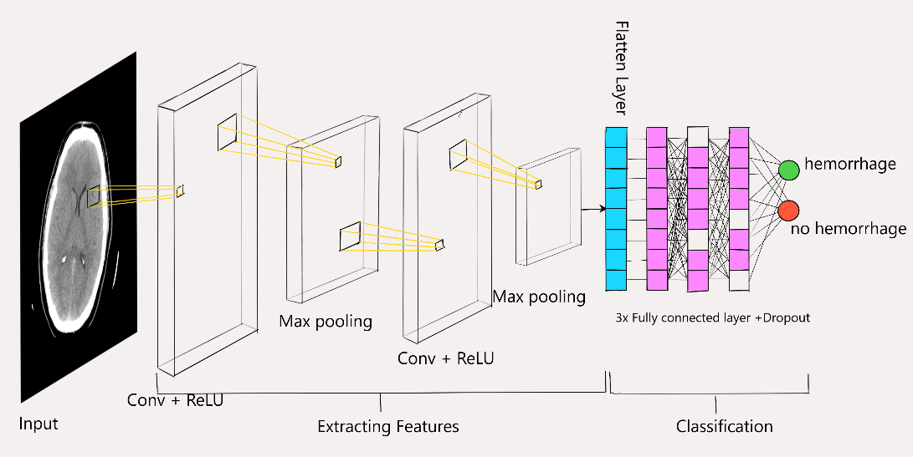
Experiment No.1 Binary classification
Model Architecture
CNN1 in_channels=1, out_channels=16, kernel_size=3, stride=1, padding=0
CNN2 in_channels=16, out_channels=32, kernel_size=3, stride=1, padding=0
MaxPool2d(kernel_size=2)
layer_1 = nn.Linear(125*125*32, 64)
layer_2 = nn.Linear(64, 64)
layer_out = nn.Linear(64,2)
Figure 8. Our CNN model architecture for binary classification

Slide 15
Experiment No.1 Binary classification
Results
BCEWithLogistLoss as loss function
Adam Optimizer as an optimizer
Accuracy | Recall | F1 measure | ROC
0.636 | 0.67 | 0.71 | 0.761

Slide 16
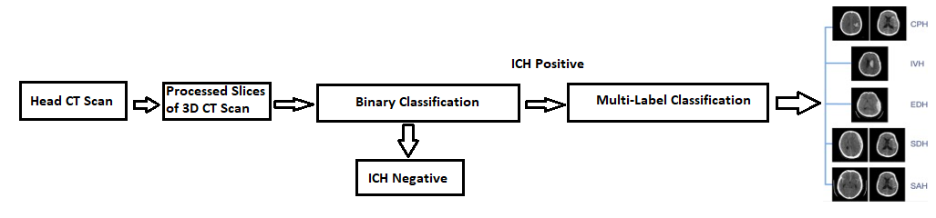
Experiment No.2 Solution Workflow
Figure 9. Illustration of the workflow of the Solution

Slide 17
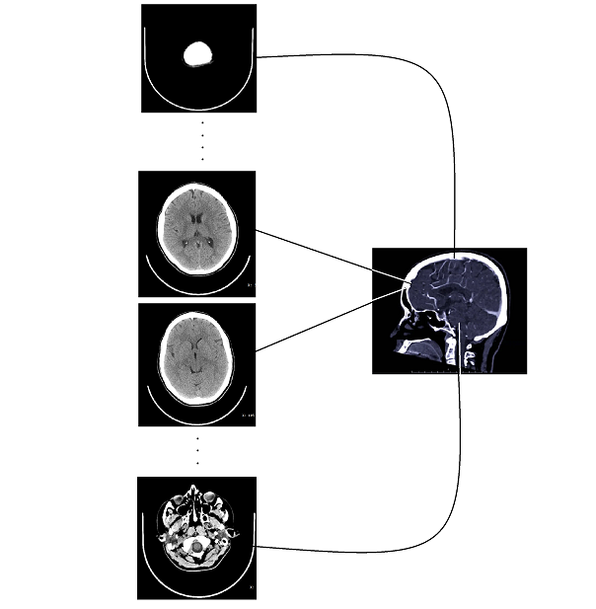
Experiment No.2 Dataset Preprocessing
Because of the extreme variation of the dataset, we choose the middle slices to train our model
Creating 2 datasets
 | Train Dataset | Test Dataset
Binary classification Dataset | 78116 | 19529
Multi-class Classification Dataset | 22501 | 5756
Figure 10. Illustration of choosing the slices to create clean dataset
Table 4. Details of both datasets

Slide 18
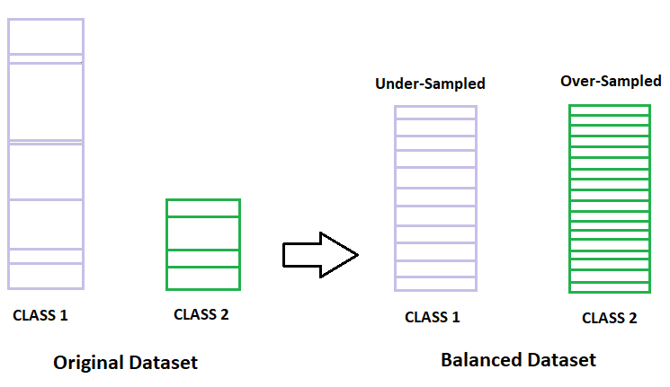
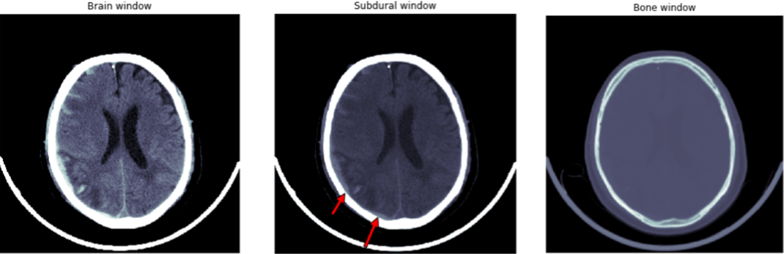
Experiment No.2
Image Preprocessing
Resampled to 512x512 pixels and then downscaled to 256x256 pixels, followed by random cropping 224x224
Apply windowing of three layers (Bone, Brain, Subdural) and stack them to create 3 channels image
Balancing datasets
Using class weights
Hyper method between down sampling and up sampling
Figure 11. Bone, Brain, Subdural Windows
Figure 12. Illustration of data-based approaches, which includes a hybrid method of under-sampling, over-sampling

Slide 19
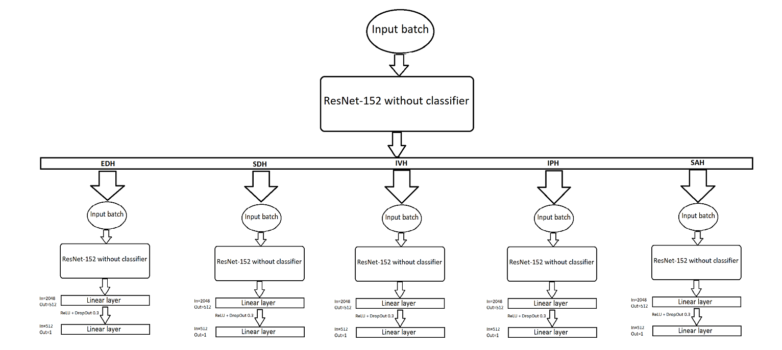
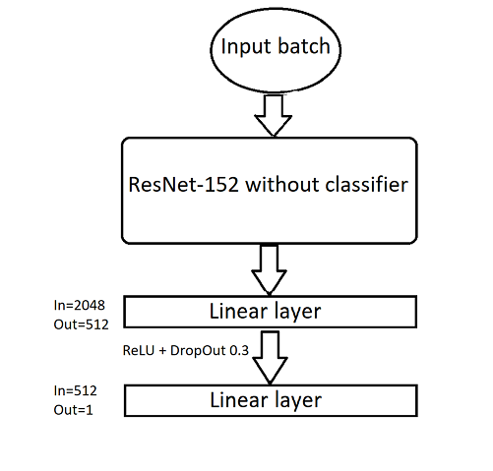
Experiment No.2 Models
We modified ResNet-152 for Both of Binary classification and Multi-class classification task
For Multi-class classification model, we made 5 parallel layers for each ICH subtype
Figure 13. Illustration of Binary classification model
Figure 14. Illustration of Multi classification model

Slide 20
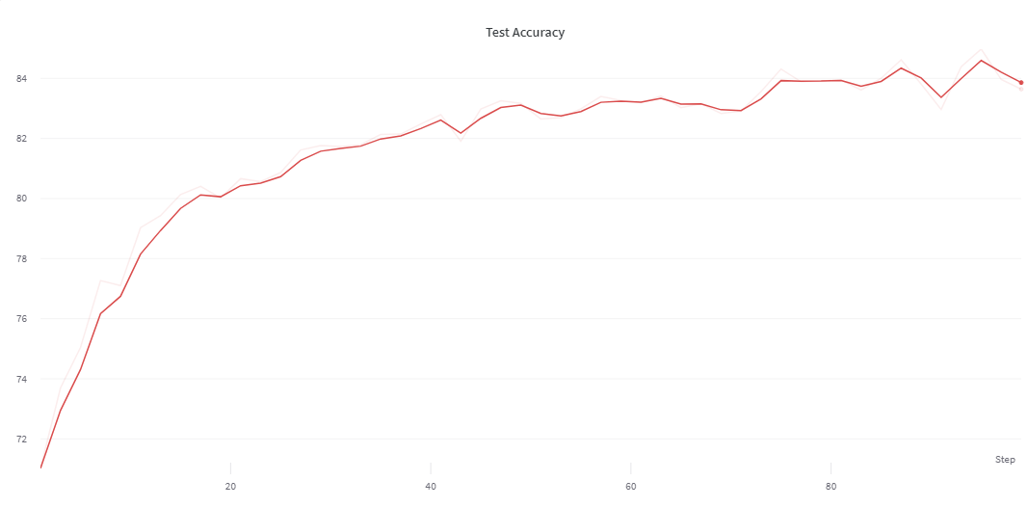
Binary classification Experiment No.2
Training and validating
Has been trained with the shown hyperparameters
Got an accuracy of 84% on test dataset.
Figure 15. Test accuracy score on testing data after each epoch
Name | Train Batch Size | Test Batch Size | Epoch | Learning Rate | Momentum | Optimizer
Value | 32 | 32 | 50 | 1e-3 | 0.9 | SGD

Slide 21
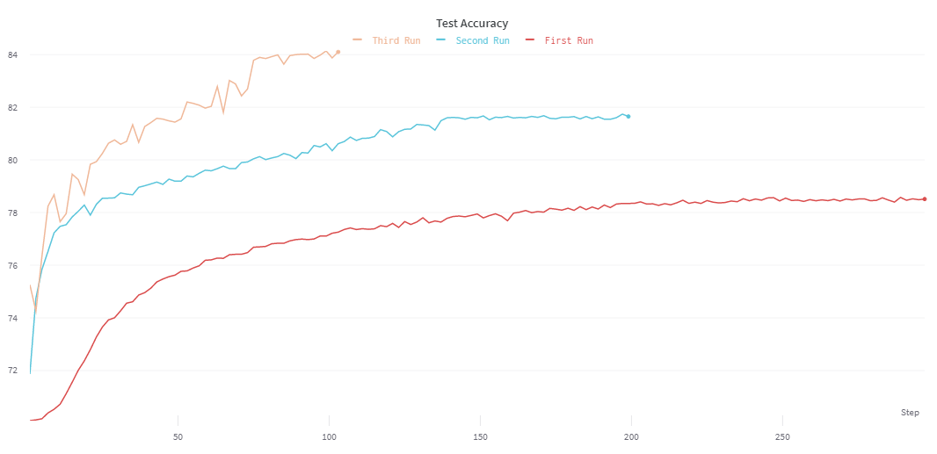
Multi-class classification Experiment No.2
Training and validating
Has been trained with the 3 different set of hyperparameters
Auto adjust LR when validation loss stopped decreasing
Got an accuracy of 84% of average across all classes on test dataset
Figure 16. Test accuracy score on testing data after each epoch
Name | Train Batch Size | Test Batch Size | Epoch | Learning Rate | Momentum | Optimizer
First Run | 32 | 32 | 150 | 1e-4 | 0.9 | SGD
Second Run | 32 | 32 | 100 | 1e-3 | 0.9 | SGD
Third Run | 32 | 32 | 50 | 1e-2 | 0.9 | SGD

Slide 22
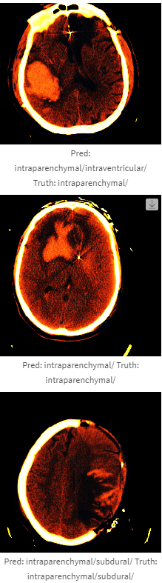
Examples Multi-Class classification
Sigmoid Windowing: increase the variance near the center of the window, due to high chance of it being within the brain range and while limiting the variance at the extremes, as it is at the edge of the brain range
Applying the sigmoid function on Brain, Subdural, and Bone Windowing together
Type window(center, width)
Brain window(40, 80)
Subdural window = (80, 200)
Bone window = (600, 2000)

Slide 23
Conclusion
We designed Binary and multi-class classification model to identify ICH and its subtypes using deep neural network solution and testing them on real medical datasets
Create our own dataset
Clean our dataset
Build two models
For both models we got an accuracy on the test dataset around 84%
With further research and some tweaks, the model could be optimized to get more accurate results.

